Slide 1
Identification of Different Medicinal Plants/Raw materials through Image Processing Using Machine Learning Algorithms
PIP4004 University Project
Review-0
Batch Number:CSE_CAI_CAP_07
Under the Supervision of,
Dr. Afroz Pasha
Assistant Professor
School of Computer Science and Engineering
Presidency University
Roll Number | Student Name
20211CAI0078 | B MEENU
20211CAI0201 | V DEEKSHITHA
20211CAI0180 | GADDAM SAI LIKHITHA
20211CAI0115 | AISHWARYA VILAS PATIL
Name of the Program: Btech-CAI
Name of the HoD: Zafar Ali Khan
Name of the Program Project Coordinator:
Name of the School Project Coordinators: Dr. Sampath A K / Dr. Abdul Khadar A / Mr. Md Ziaur Rahman

Slide 2
Content
Problem Statement
Github Link
Analysis of Problem Statement
Timeline of the Project
References

Slide 3
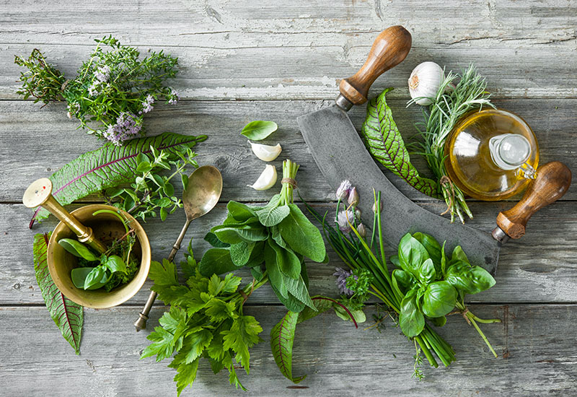
Problem Statement Number: 66
Organization: Ministry of AYUSH
Category (Hardware / Software / Both) :Software
Problem Description: India's diverse medicinal plants are vital for traditional Ayurvedic medicine. However, misidentification can lead to incorrect treatments and damaged consumer trust. A robust software solution using image processing and machine learning algorithms can help accurately identify these plants, providing instant identification results.
Difficulty Level: Complex

Slide 4
Github Link
The Github link provided should have public access permission.
Github Link
https://github.com/meenub255/Identification-of-Medicinal-Plants-Raw-materials-through-Image-Processing-Using-Machine-Learning

Slide 5
Analysis of Problem Statement
Technology Stack Components-Software Requirements:
Python: 3.11.5
Flask Framework: 2.3.3
Plant Species & Raw Materials Image Dataset
Visual Studio Code: 1.82
Firebase Database: 12.5.1
Google Collaboratory

Slide 6
Analysis of Problem Statement-Objectives
Develop a ML Model for Medicinal Plant Identification.
Create a Curated Dataset of Medicinal Plants and Raw Materials.
Extract and Analyze Unique Visual Features for Classification
Build a Prototype Application for Practical Demonstration

Slide 7
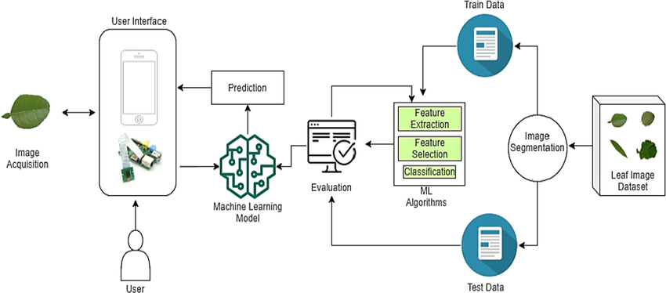
Analysis of Problem Statement-Methodology

Slide 8
Timeline of the Project (Gantt Chart)
Title finalization with Supervisor 29-01-25
Literature Survey
29-01-25
Finalizing the objectives 29-01-25
Deciding the methodology
29-01-25

Slide 9
References (IEEE Paper format)
Karuna Middha, Mohit Taneja, Aditya Khurana, and Bhavuk Gupta, “Identification of Different Medical Plants through Image Classification,” Int. J. Eng. Res. Comput. Sci. Eng. (IJERCSE), vol. 11, no. 2, pp. 1–6, Feb. 2024.
V. Swu, I. Kharir, and D. Bora, “Identification of Different Plants through Image Processing Using Different Machine Learning Algorithms,” Sambodhi, vol. 43, pp. 172-179, 2020.
B. Dey, J. Ferdous, R. Ahmed, and J. Hossain, "Assessing deep convolutional neural network models and their comparative performance for automated medicinal plant identification from leaf images," Heliyon, vol. 10, no. 1, e23655, 2024. [Online]. Available: https://doi.org/10.1016/j.heliyon.2023.e23655
L. Li, Z. M. Li, and Y. Z. Wang, "A method of two-dimensional correlation spectroscopy combined with residual neural network for comparison and differentiation of medicinal plants raw materials superior to traditional machine learning: A case study on Eucommia ulmoides leaves," Plant Methods, vol. 18, no. 1, p. 102, 2022.
P. Li, T. Shen, L. Li, and Y. Wang, "Optimization of the selection of suitable harvesting periods for medicinal plants: Taking Dendrobium officinale as an example," Plant Methods, vol. 20, no. 1, p. 43, 2024.
H. I. Yoon, H. Lee, J. S. Yang, J. H. Choi, D. H. Jung, Y. J. Park, and S. H. Park, "Predicting models for plant metabolites based on PLSR, AdaBoost, XGBoost, and LightGBM algorithms using hyperspectral imaging of Brassica juncea," Agriculture, vol. 13, no. 8, p. 1477, 2023.
M. A. Kiflie, D. P. Sharma, and M. A. Haile, "Deep learning for Ethiopian indigenous medicinal plant species identification and classification," Journal of Ayurveda and Integrative Medicine, vol. 15, no. 6, p. 100987, 2024. [Online]. Available: https://doi.org/10.1016/j.jaim.2024.100987
P. K. Sekharamantry, Dr. S. Rao, Y. Srinivas, and A. Uriti, "PSR-LeafNet: A Deep Learning Framework for Identifying Medicinal Plant Leaves Using Support Vector Machines," Big Data and Cognitive Computing, vol. 8, no. 12, p. 176, 2024. doi: 10.3390/bdcc8120176.

Slide 10


